Slide 1




The Initiative for Climate Action Transparency
An overview of ICAT’s support to countries
Henning Wuester, Director of ICAT
SB50 Side-event:
Enhancing transparency around NDCs for benefits beyond reporting 21 June 2019

Slide 2
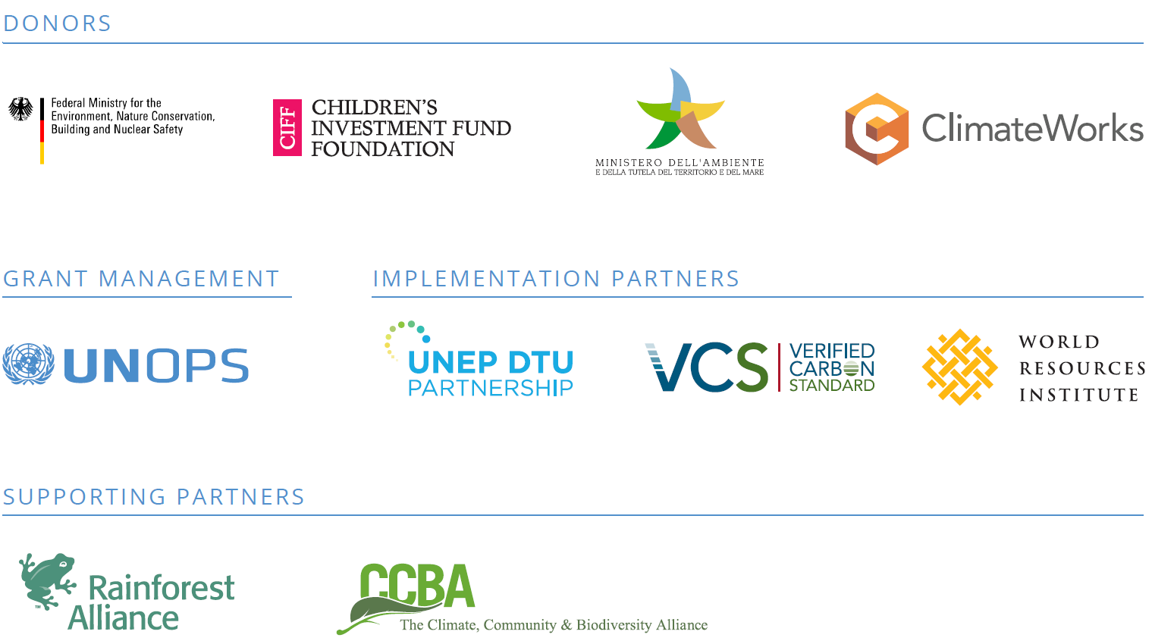






ICAT: A multi-stakeholder partnership
Notes:
ICAT is funded and overseen by the four donor organizations at the top of this slide.
It is hosted by UNOPS which manages the funds and the secretariat.
Four partners: the UNEP-DTU partnership, Verra, World Resources Institute and ISPRA are implementing ICAT’s activities.
The initiative is supported by a number of other organizations shown here on the screen, including the UNFCCC, represented ex officio on the Donor Steering Committee

Slide 3
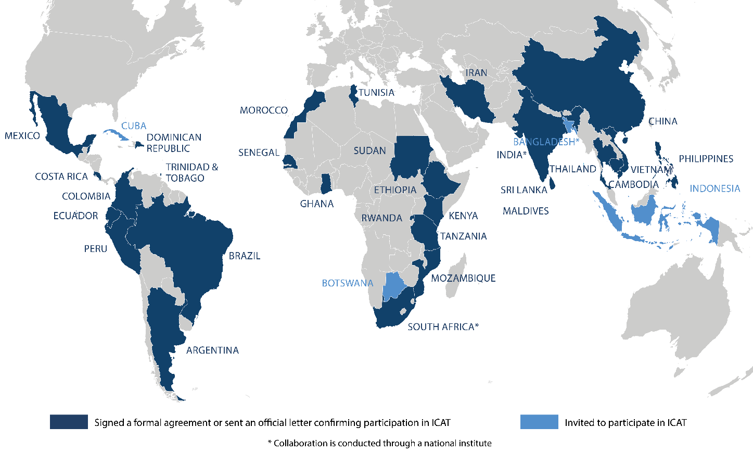
ICAT countries
Notes:
34 countries have been invited
30 accepted either through a formal agreement or a formal letter
For more than half of these, work is well under way and coming to a close soon.

Slide 4

Benefits of enhanced transparency
    Evidence-based policy-making and implementation
    Stakeholder integration: horizontally and vertically
    Accountability: showing results nationally, internationally and to financiers

Slide 5

Transparency to be used beyond reporting
Looking beyond GHG emissions to socio-economic and environmental indicators, and investment-maturity
Notes:
National development priorities: growth, job creation, social, environmental (air and water quality), etc.
Transformational change: mobilizing investment – public (climate) resources and private finance
GHG emission reductions towards the global policy objective (< 1.5/2º C)
Competitiveness concerns in climate action

Slide 6
ICAT’s objectives
Provide policymakers around the world with tools, capacity-building and support for enhanced transparency.
Work and support provided is:
Country-driven, tailored to the country context and priorities;
Builds on existing MRV/transparency systems and knowledge; and
Covering all aspects of the Enhanced Transparency Framework of the Paris Agreement.
Notes:
The objective of ICAT is to provide policymakers with tools and support to measure and assess the effectiveness of their country’s climate actions in line with the Paris Agreement.
This entails two main activities:
Work on Methodologies to help countries assess the GHG, sustainable development and transformational impacts of policies and actions in an integrated way.
Capacity building: Supporting countries towards improving policy design and impact assessment capacity; supporting all aspects of the ETF

Slide 7










ICAT Methodologies
Impact Assessment Guidance Documents
Greenhouse gas impacts:
Process Guidance Documents:
Notes:
ICAT provides a toolbox of methodologies for the assessment of the GHG, sustainable development and transformational impacts of policies and actions.
The series of guidance is comprised of 10 guidance documents, which are shown in this figure.
At the core are the impact assessment guidance documents (in light blue), which cover GHG impacts for various sectors and crosscutting impacts that look beyond.
These methodologies are supported by further guidance on topics such as stakeholder participation (in dark blue).

Slide 8
Examples of country applications
Costa Rica: ICAT Sustainable Development and Transformational Change methodologies applied in the transport sector. Sectoral approach, tailor-made to assess impacts of NDC policies and actions to SDGs and national TC vision.
Sri Lanka: ICAT Transport Pricing methodology, adapted to country specific needs.
Kenya: ICAT Sustainable Development and Stakeholder Participation (SP) methodologies: Comprehensive approach to SDG impacts applied to solar policy in the energy sector; SP applied jointly with CBIT to develop institutional capacity for MRV
Mozambique: ICAT Sustainable Development applied to a NAMA on sustainable charcoal production. Renewable Energy methodologies applied to a Decree that introduces feed-in tariffs for all key types of renewable energy. ICAT Modelling of NDC baseline.

Slide 9
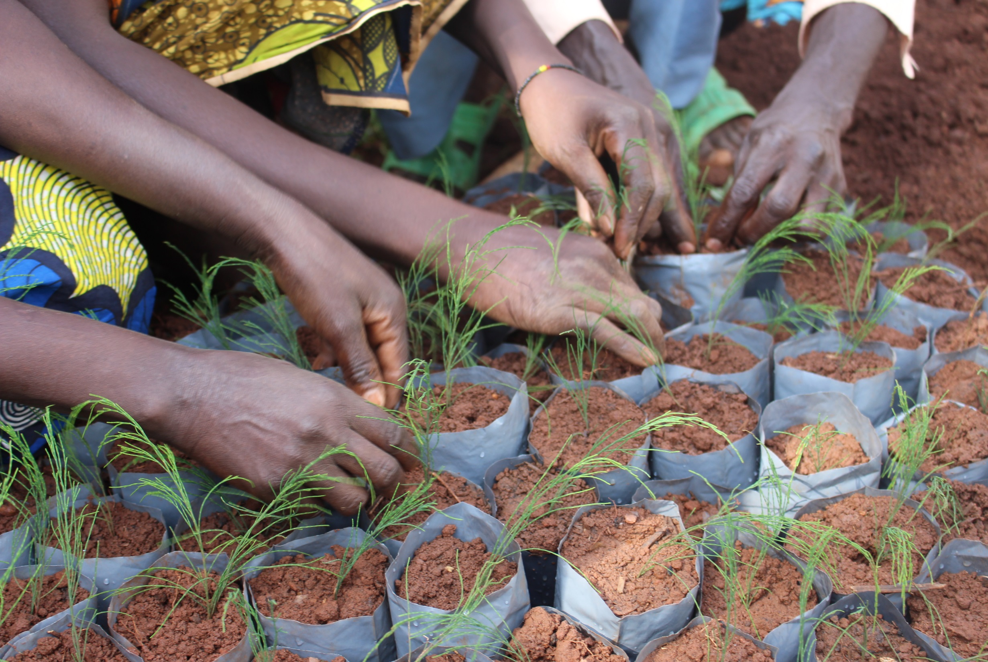

Thank you!
www.climateactiontransparency.org
Contact: ICAT@unops.org

Slide 10
ICAT offers to countries support to:
    Build / enhance transparency systems, including: institutional capacity; data systems; data quality
    Track progress in implementing the NDCs (in accordance with indicators chosen) and enhance them
    Assess impacts of policies, in term of GHG emissions and socio-economic and sustainable development parameters
    Integrate/aggregate transparency at sub-national level and for non-state actors
    Identify domestic benefits from enhanced transparency systems, including in mobilizing finance

