Slide 1
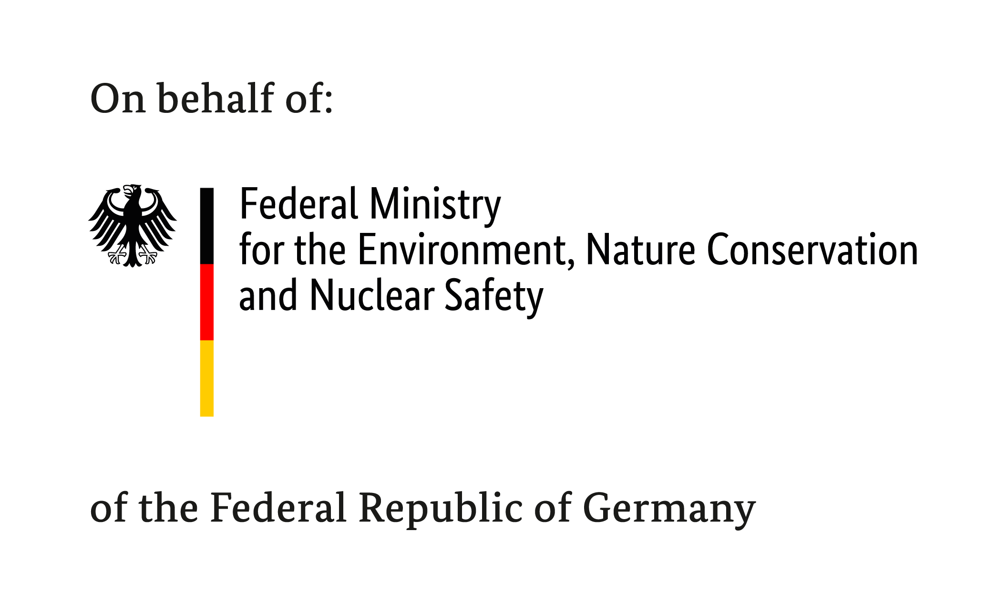



GIZ Support for Transparency:
PATPA & Information Matters
“Enhancing transparency around NDCs for benefits beyond reporting“
Side Event | 21 June 2019 – Klaus Wenzel, GIZ

Slide 2





Information Matters
  Launched in September 2013 – project closure June 2019, will be integrated in Transparency Partnership (PATPA)
  Commissioned by the German Federal Environment Ministry (BMU) in the framework of the International Climate Initiative (IKI)
  Goal: Strengthen in-country capacities for enhanced reporting through BURs and NCs
  Activities:
    Stock-staking of MRV-systems and development of road-maps
    Provision of in-country tailored capacity-building and training
    Peer-to-peer exchange and generation of knowledge products
www.transparency-partnership.net/information-matters

Slide 3
Information Matters
7 IM Partner Countries
Mongolia
Georgia
Kyrgyzstan
Dominican Republic
Algeria
Lebanon
Tajikistan
Niger
Jordan
Vietnam
Burkina Faso
14 Countries supported under the Ad-hoc Facility
Laos
Philippines
Colombia
Benin
Malaysia
Ghana
Zambia
Eswatini
Chile
South Africa

Slide 4
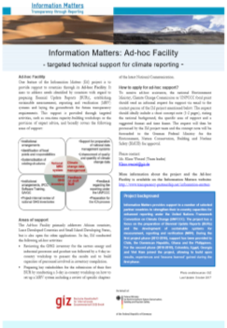
Information Matters – Ad hoc Facility
  Targeted in-country CB-support for African countries, LDCs and SIDS (also open for applications by other developing countries)
  Bridges support gaps between different projects / initiatives
  Flexible, quick and easy application
  Potential support areas:
    preparing Biennial Update Reports,
    establishing sustainable MRV-systems and
    laying the basis for ETF requirements
  For more information see: Ad-hoc Facility Factsheet

Slide 5

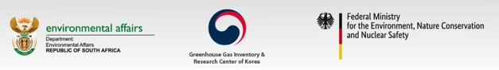
Partnership on Transparency in the Paris Agreement
History & Objectives
Launched in 2010 at the Petersberg Climate Dialogue by South Africa, the Republic of Korea and Germany
Aim: promoting ambitious climate action through enhanced transparency
The Partnership:
  fosters transparency, communication, networking and trust between countries;
  provides capacity building and promotes mutual learning within regions and among negotiators and practitioners on a global scale
  identifys and disseminates good practice examples and lessons learnt

Slide 6
Partnership on Transparency in the Paris Agreement
Partnership Formats include:
  Annual Partnership Retreats to discuss crucial issues of the UNFCCC negotiations
  Peer-to-peer learning and capacity building activities through technical workshops in 5 regional and language groups, and through international conferences
  Partnership Meetings held in the margins of UN climate negotiations
  Knowledge sharing and knowledge products, e.g. through newsletters and www.transparency-partnership.net

Slide 7



Overview of the Climate Helpdesk
SPA 2.0 (from July 2019)
Climate Helpdesk
NDC and LEDS
Transparency

Slide 8

Contact & information:
Thank you!
info@transparency-partnership.net
www.transparency-partnership.net
www.twitter.com/TrackingClimate

Slide 9
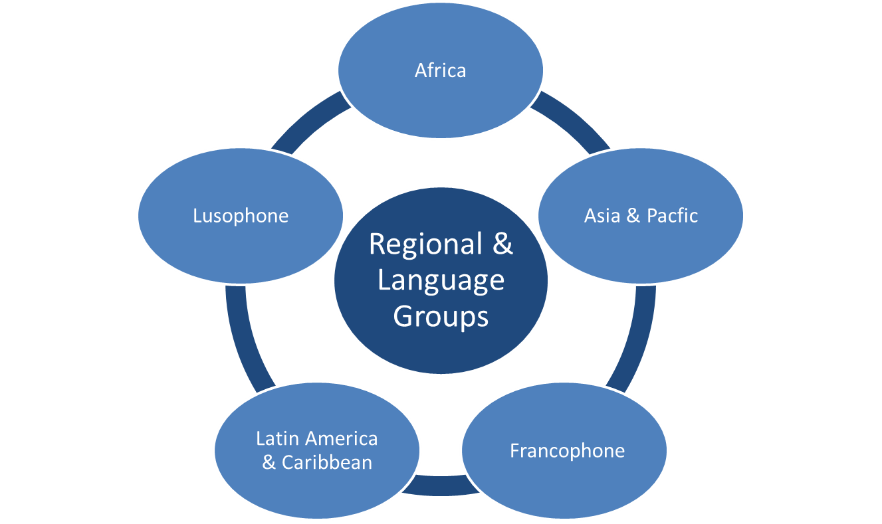
Partnership on Transparency in the Paris Agreement
Regional & Language groups

Slide 10
Partnership on Transparency in the Paris Agreement
  Good Practice Database:
  Serves as a central hub for case studies on learning and leadership in climate action
  Easily-searchable data base of good practice examples
    Cases where climate action is effectively designed and implemented
    Cases in which countries have overcome obstacles to implementation
  Jointly established by PATPA, IKI NDC Support Cluster, UNDP
  NDC Support Programme, LEDS GP and NDC Partnership
    Full content is accessible through all partner’s websites
  Online database PATPA:
  https://www.transparency-partnership.net/good-practice-database

