Slide 1
Side Event: Enhancing transparency around NDCs for benefits beyond reporting
Challenges and benefits in meeting MRV requirements under the UNFCCC
Dirk Günther
German Environment Agency
Section Emissions Situation

Slide 2
Main challenges faced in the establishment of the MRV system
Institutional Arrangements
Delay in recent energy data / energy balance
Ownership for the „Product“
Lack of data in the official statistics
Access to higher Tier DatA
Dealing with confidential data

Slide 3
Details on the Institutional Arrangements:
Cooperation Agreements with enterprises and business associations
Codified Cooperation Agreements
preferred form of cooperation with the private sector
Agreements with 5 business association and 3 enterprises
establish details on the cooperation, data provision, QA/QC information and contact information
Voluntary Commitments
early model of cooperation with the private sector
discontinued model: successive replacement by formal cooperation agreements
Associations commit themselves to provide annually activity data
Information on QA/QC are not settled, but were provided separately

Slide 4
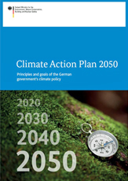

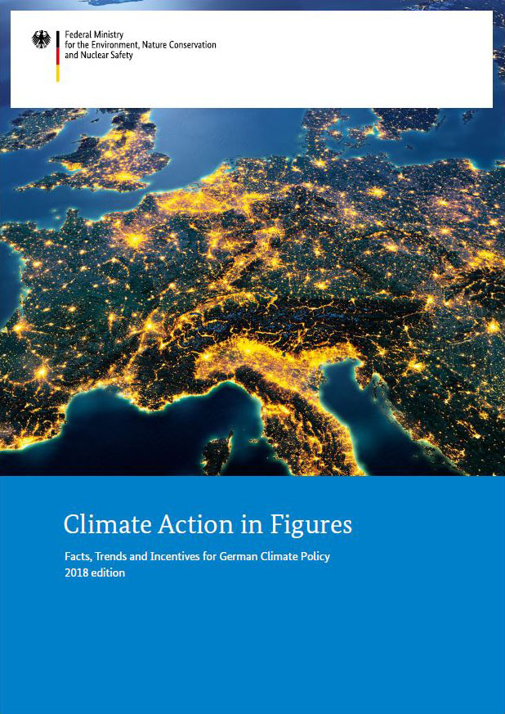

National benefits from established MRV System

